Slide 1
Predict the survival of the passengers aboard RMS Titanic
Satyawant Kumar
2017118062

Slide 2

Introduction
The sinking of the RMS Titanic is one of the most infamous shipwrecks in history.
The RMS Titanic was a British passenger liner that sank in the North Atlantic Ocean in the early morning hours of 15 April 1912, after it collided with an iceberg during its maiden voyage from Southampton to New York City.
There were an estimated 2,224 passengers and crew aboard the ship, and more than 1,500 died, making it one of the deadliest commercial peacetime maritime disasters in modern history.

Slide 3
Goal & Objective
The objective is to perform data analytics to mine various information which are available in the dataset and to know effect of each field on survival of passengers by applying analytics.
In particular, we will try to apply the tool of machine learning that is “Logistic Regression” to predict which passengers survived the tragedy.

Slide 4
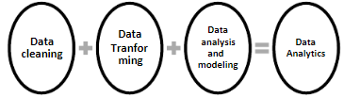
Data Analytics Diagram

Slide 5
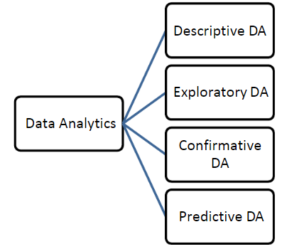
Categories of data Analytics

Slide 6
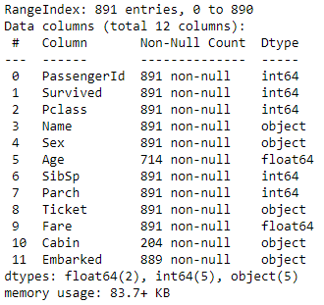
Description of data
In Python info() function is used to find structure of dataset that we have in csv file. Below there is a snippet of output which we got by executing info() in Python.

Slide 7
Data Analysis
We have performed “Exploratory Data Analysis” for our problem in the first stage.
In exploratory data analysis dataset is explored to figure out the features which would influence the survival rate.
The data is deeply analysed by finding a relationship between different attribute and survival.

Slide 8
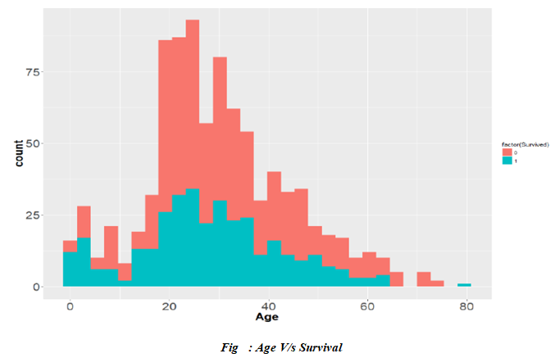
Cont...

Slide 9
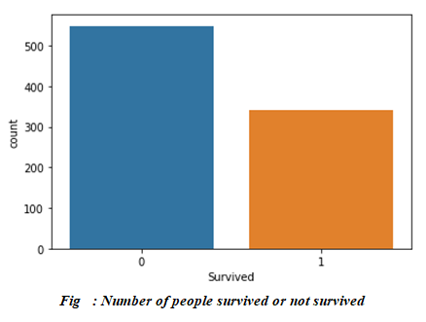
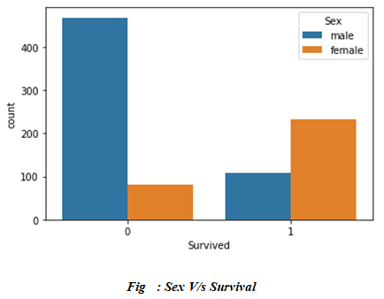
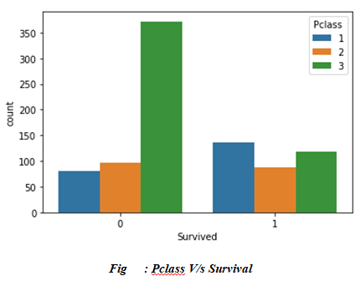
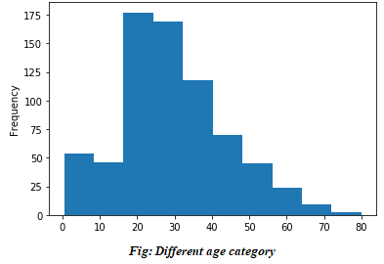
Cont...

Slide 10
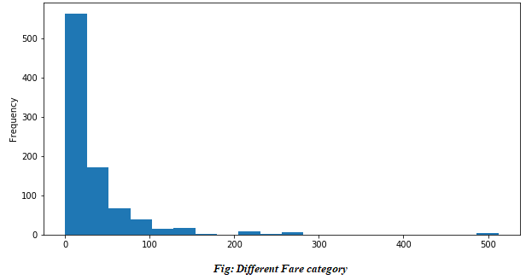
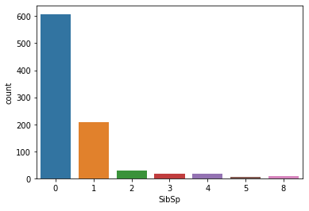
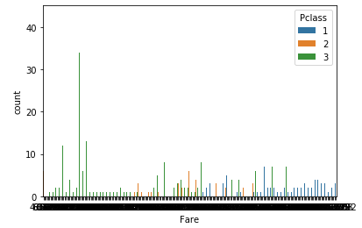
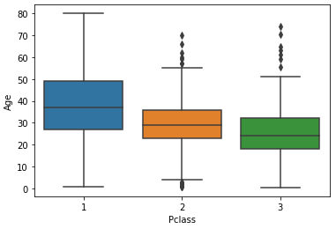
Cont…

Slide 11
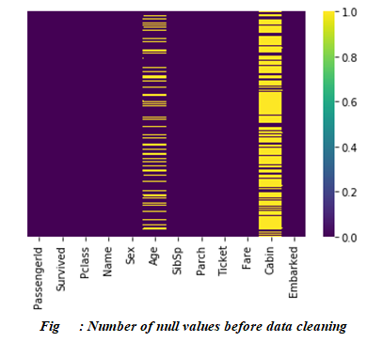
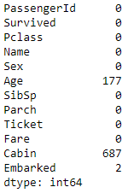
Data wrangling and cleaning
Before applying any type of data analytics on the dataset, the data is first cleaned. There are some missing values in the dataset which needs to be handled.
Below figure displays the number of missing or null values for a particular attribute in the dataset.
Below figure displays the number of missing or null values for a particular attribute in the dataset
. We can see that the attribute “Cabin” has the highest number of missing values.

Slide 12
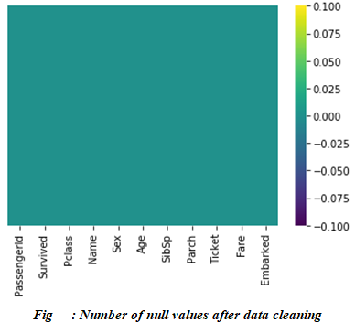
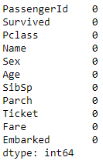
Cont...
Before creating our model we need to either fill those fields with some dummy values or the mean value of that particular attribute.
Here, in my model we just dropped that row which contains any null or missing values.
After performing data wrangling we got the cleaned dataset which can be seen in the figure below.

Slide 13
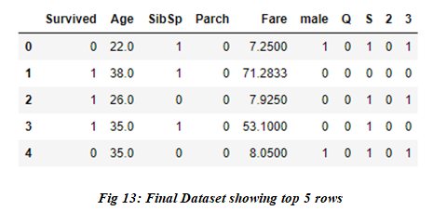
Final Dataset after data wrangling

Slide 14
Logistic Regression
Logistic regression is the technique which works best when dependent variable is binary or categorical.
It is used to solve binary classification problem, some of the real life examples are spam detection- predicting if an email is spam or not, health-Predicting if a given mass of tissue is benign or malignant, marketing-predicting if a given user will buy an insurance product or not.
For training our model, we divided the whole dataset into 60 – 40 ratio and defined X and Y axis variable. We have assigned “Survived ” attribute which is a dependent variable to Y-axis and all other attributes accept survived which are independent attributes has been assigned to X-axis.

Slide 15
Prediction
Then, we performed the prediction on our dataset using the model called “Logistic Regression”.

Slide 16
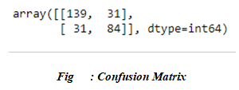
Model Evaluation
The accuracy of the model is evaluated using “confusion matrix”.
A confusion matrix is a table layout that allows to visualize the correctness and the performance of an algorithm.
Below figure shows the confusion matrix which we got for the model.

Slide 17

Accuracy
It gives the measure of percentage of correct prediction done by the model/algorithm. The best value is “1.0” and the worst value is “0.0”.
In our model we got an accuracy score of 78.24%, which is not so bad.
Along with the confusion matrix and accuracy sore we have also generated classification report for evaluating our model which is shown in the figure below.

Slide 18
Conclusion
There is high influence of age on survival. We can see from the above figure 8 that as age increases survival decreases. It can be seen that survival rate of female is very high (approx. 74%) and survival rate of male is very low.
This fact can also be verified by extracting titles (Mr, Mrs, Ms etc) from name column. Survival rate with title Mr. is approximately 16% while survival rate for Mrs. is 79%.
We found that Passengers who were travelling in first class is more likely to survive.

Slide 19
Thank You

